Slide 1
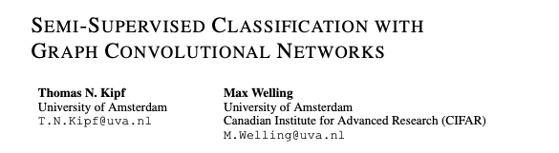
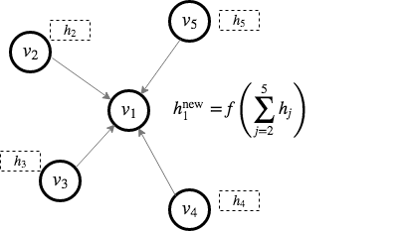
https://arxiv.org/pdf/1609.02907.pdf
https://tkipf.github.io/graph-convolutional-networks/

Slide 2
https://arxiv.org/pdf/1609.02907.pdf
https://tkipf.github.io/graph-convolutional-networks/

Slide 3
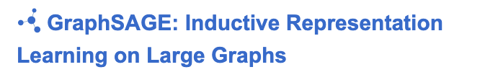
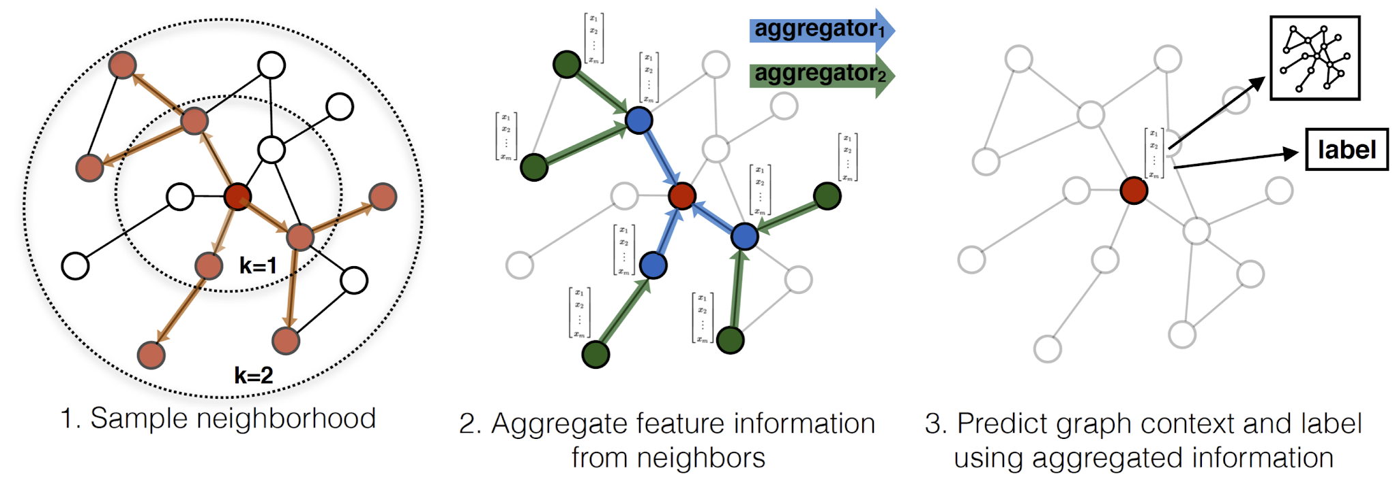
GraphSage
Two problems with early GNNs:
Only fixed graph size/structure
Unknown graphs
Changing structure
Require entire graph during training
Scalability
≠ mini-batches in NN
http://snap.stanford.edu/graphsage/
https://cs.stanford.edu/people/jure/pubs/graphsage-nips17.pdf

Slide 4
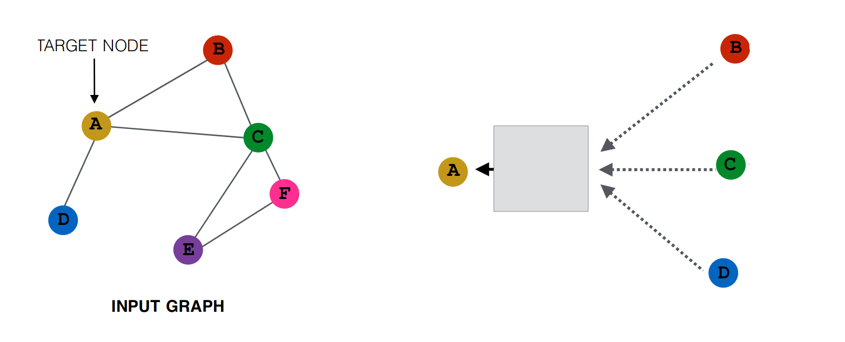
GraphSage
Inductive
Problem fixed graph graph (transductive)
How to deal with changing/Unknown graphs?
We need an embedding function generalizing to unseen nodes
http://snap.stanford.edu/graphsage/
https://dsgiitr.com/blogs/graphsage/
Notes:
Bonus Lab: https://github.com/dsgiitr/graph_nets/blob/master/GraphSAGE/GraphSAGE_Code+Blog.ipynb
dataset: https://github.com/tkipf/pygcn/tree/master/data/cora

Slide 5
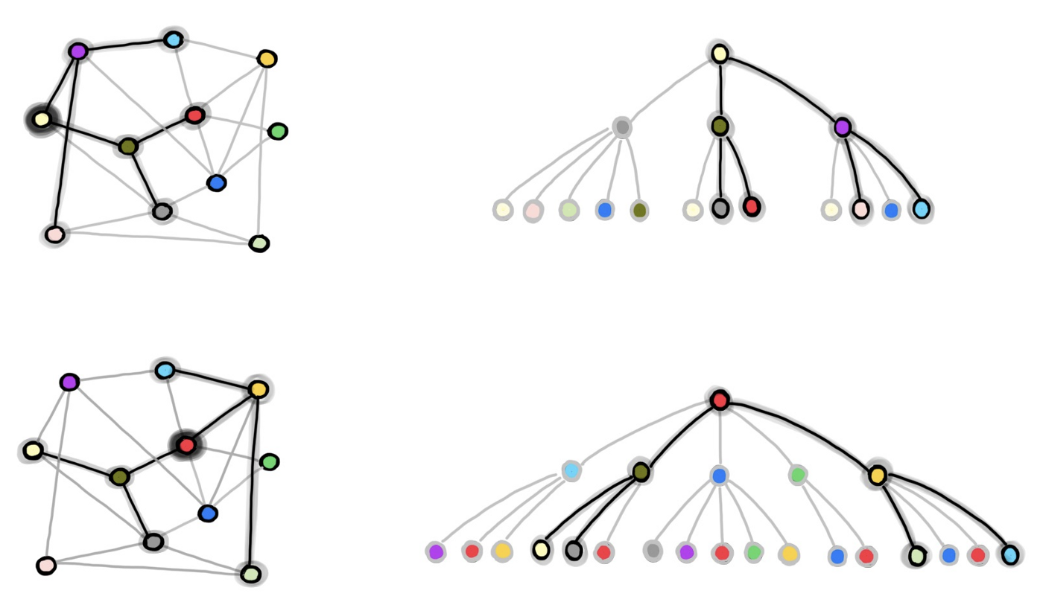
GraphSage
Large
Early GCNs considering entire Graph
≠ mini-batches in NN
Even L-hop sampling can result in huge samples (especially for small-world networks)
GraphSAGE introduces neighbourhood sampling combined with mini-batch training
Sample fixed number k of 1-hop neighbours with replacement
For each sampled neighbour sample k 1-hop neighbours
Repeat for L-hops for fixed sample size

Slide 6
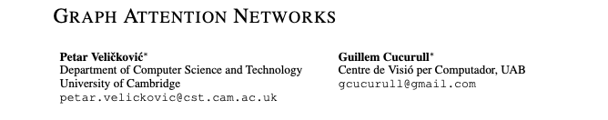
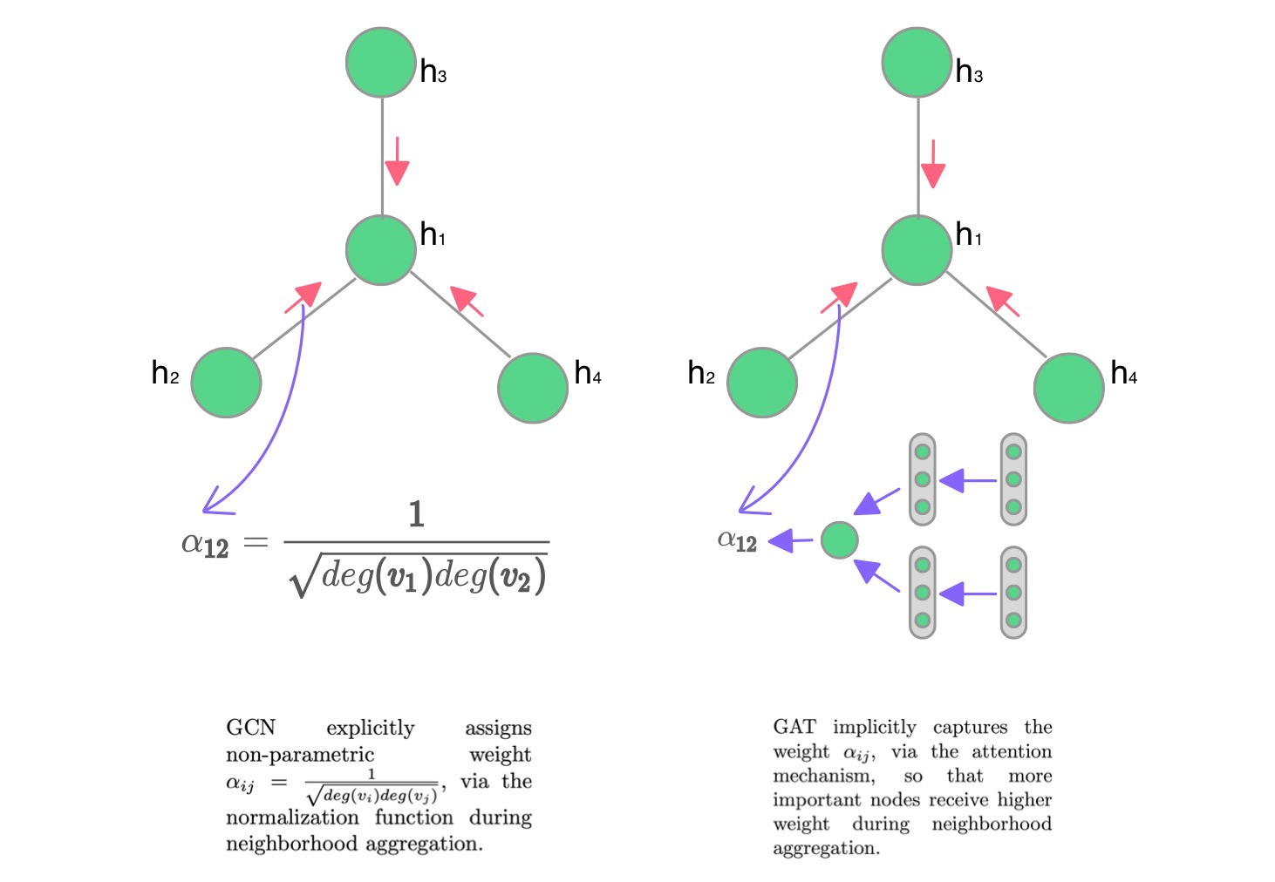
https://dsgiitr.com/blogs/gat/
https://arxiv.org/pdf/1710.10903.pdf
Notes:
Bonus https://github.com/dsgiitr/graph_nets/blob/master/GAT/GAT_Blog%2BCode.ipynb

Slide 7
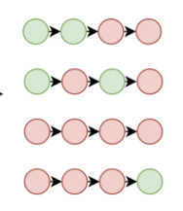
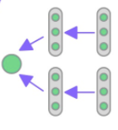
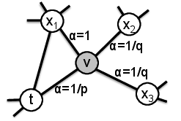
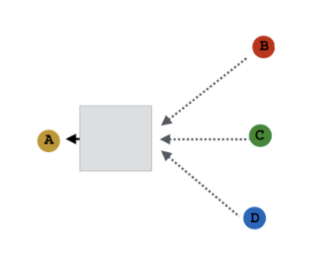
Evolution of GNNs
Deep Walk | Node2Vec | MP GCN | Graph Sage | Graph Attention Networks

Slide 8

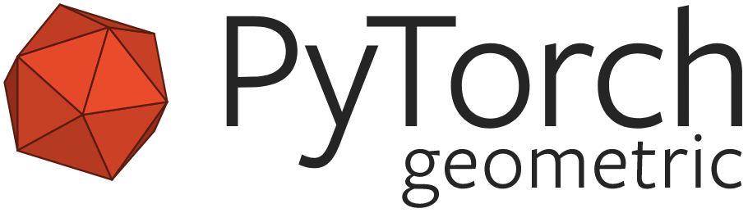

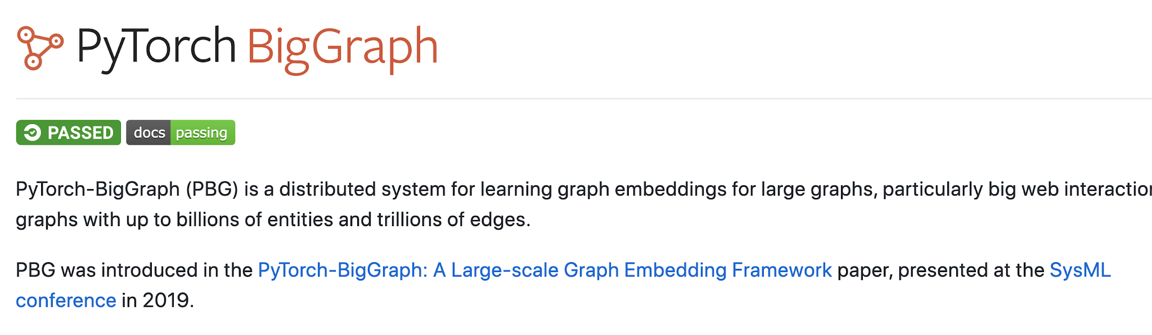
Tools

Slide 9

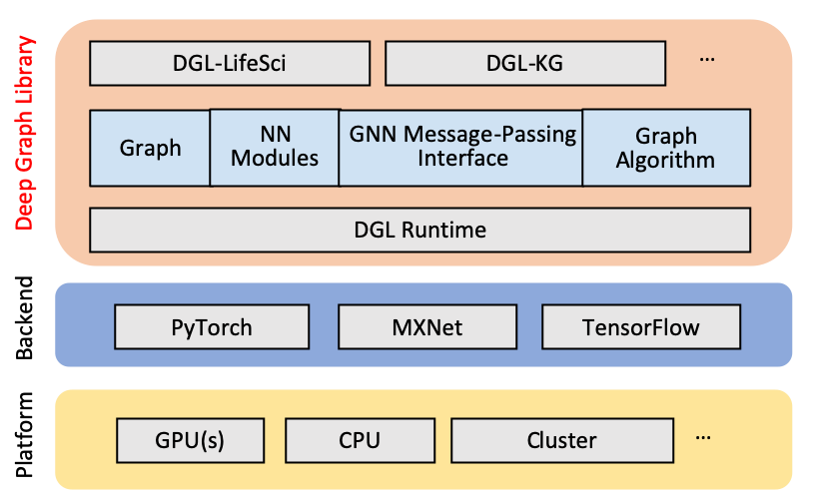
Deep Graph Library
Python Package for Deep Learning on Graphs
Support various ML Framework
Pytorch
MXNet
TensorFlow
https://dgl.ai

Slide 10


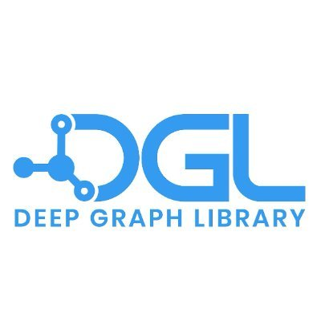
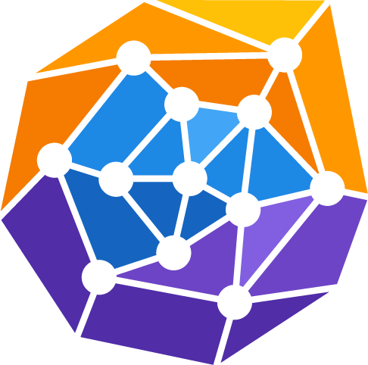
Adapter Suite
An ecosystem of plug & play adapters to support your ML & DS solutions
NetworkX Adapter
The swiss-army knife for Graph Analysis in Python.
ArangoDB to NetworkX NetworkX to ArangoDB
cuGraph Adapter
The GPU-accelerated Graph Analytics library.
ArangoDB to cuGraph cuGraph to ArangoDB
DGL Adapter
The scalable Python package for deep learning on graphs.
ArangoDB to DGL DGL to ArangoDB
PyG Adapter
The Graph Neural Network library for PyTorch.
ArangoDB to PyG PyG to ArangoDB

Slide 11
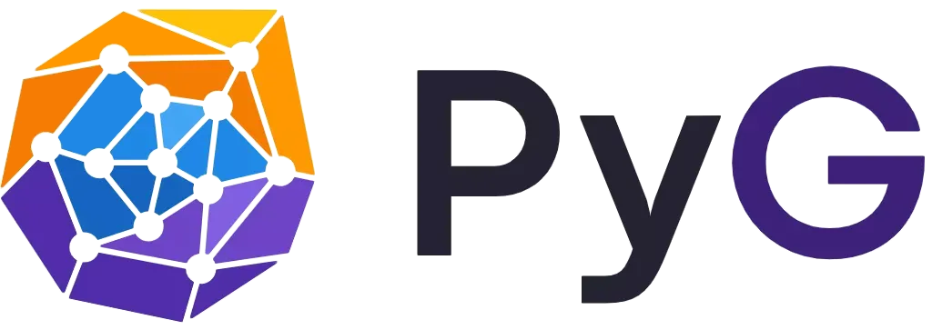

Lab: PyTorch Geometric

Slide 12

Lab: Deep Graph Library

Slide 13
Lab: PyG Node Classification

Slide 14
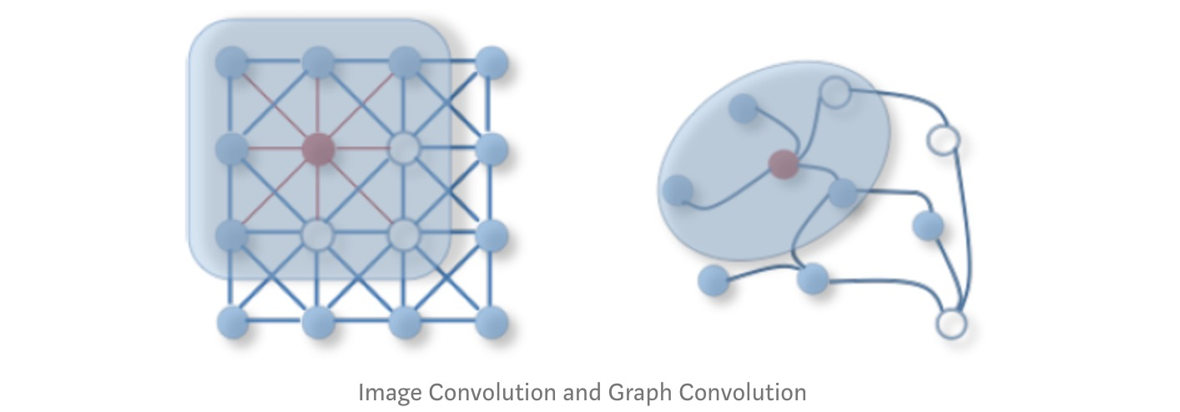
More GNNs
How to aggregate information?
Graph Convolutional Networks (GCN)
Structural Information only
Topology in Graphs
Attention (GAT)
Message Passing
Beyond Message passing
https://dsgiitr.com/blogs/gcn/
https://tkipf.github.io/graph-convolutional-networks/

Slide 15
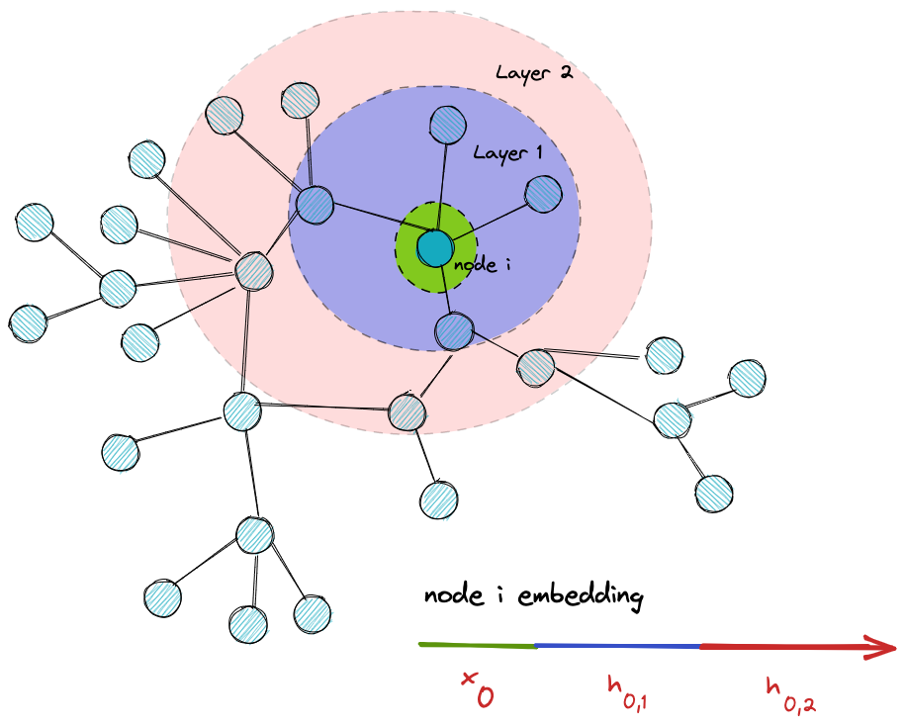
Layers in (Message Passing) GNN
Number of Layers is critical Hyperparameter
Few layers (in relation to diameter)
Information is Local
Many layers (in relation to diameter)
Oversmoothing
https://towardsdatascience.com/over-smoothing-issue-in-graph-neural-network-bddc8fbc2472

Slide 16
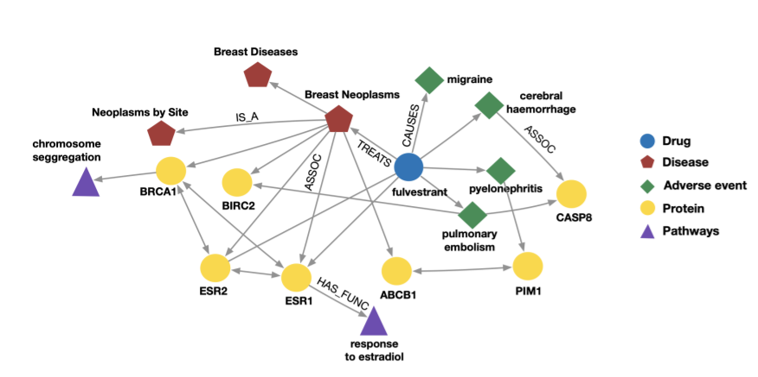
Heterogeneous Graphs
GraphSage does not distinguish Node types
HinSage extends GraphSage by weight matrices for every unique ordered tuple of (N1, E, N2) where N1, N2 are node types, and E is an edge type.
A Survey on Heterogeneous Graph Embedding: Methods, Techniques, Applications and Sources
https://stellargraph.readthedocs.io/en/stable/hinsage.html

Slide 17
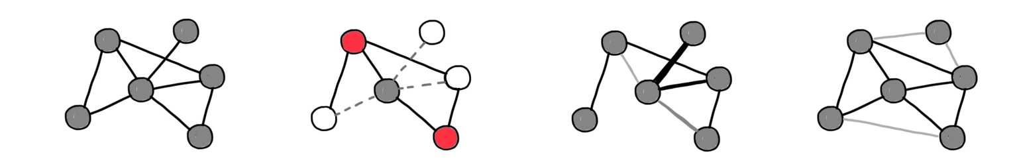
Going Beyond Compute Graph
Compute Graph (MP)
Sampling (GraphSage)
Attention (GAT)
Rewiring/
Connection Evolution (DIGL)

Slide 18
What you want to be doing
Get Data
Write intelligent machine learning code
Train Model
Run Model
Repeat

Slide 19
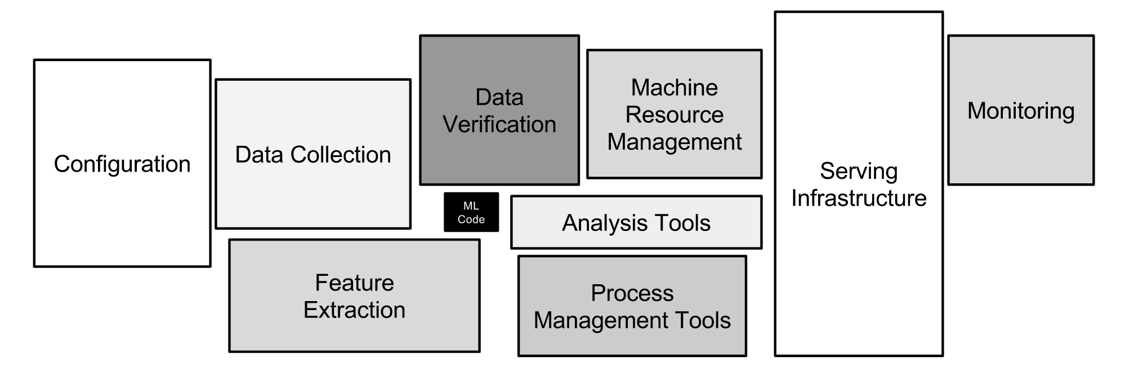
What you’re actually doing
Sculley, D., Holt, G., Golovin, D. et al. Hidden Technical Debt in Machine Learning Systems

Slide 20



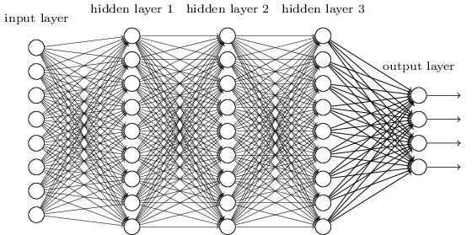



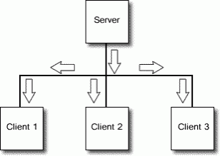








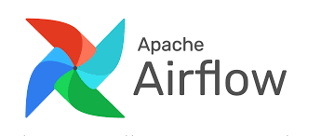



Monitoring & Operations
TensorBoard
Data & Streaming
Model Engineering
Model
Training
Model Management
Model Serving
Distributed Data Storage and Streaming
Data Preparation and Analysis
Distributed Training using Machine Learning Frameworks
Storage of trained Models and Metadata
Use trained Model for Inference
Feature Catalogue
Orchestration
Notebook Library
Model Library
Resource and Service Management

Slide 21

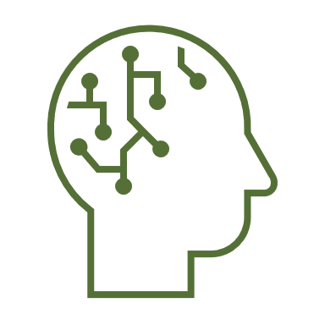



ArangoGraphML
Evolution of the Graph Database Value
Building Smart Solutions
Machine Learning
Analytics
Query Capabilities
Graph Database

Slide 22


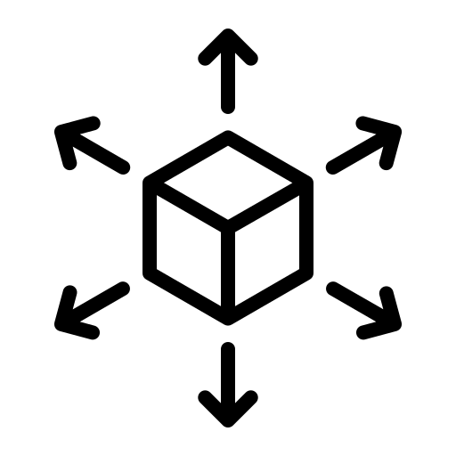
ArangoGraphML: Fast and Efficient
Easy to Use
An intuitive interface and user-friendly tools, enabling both beginners and experts to implement graph machine learning solutions effortlessly.
Fully Managed
Our SOC2 compliant service is taking care of all the underlying infrastructure, maintenance, and updates, letting you focus solely on building and deploying your machine learning models.
Elastically Scalable
Engineered to grow with your needs; whether you're handling a spike in data or expanding your model complexity or number of models.

Slide 23
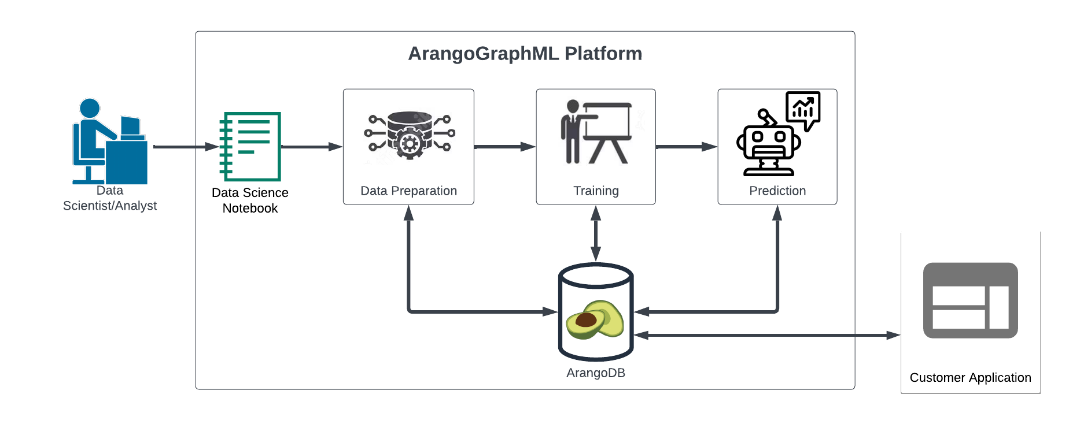
Architecture

Slide 24
ArangoGraphML Today
Applications
Notebook
Notebook Service
Input Graph Spec
Graph Preparation
Featurization
Graph Sampling
Model
Train
Build Model
ArangoDB
ArangoDB
Deploy
Data
ArangoDB
ML Platform Services
Graph Service
Similarity
Data
Grouping
Model Inference
(GraphML Solutions)
Update Service
Anomaly Detection
Data
Edge Prediction
Enterprise Knowledge Graph
Node Classification
Explain
Monitor
Metadata Services
Provenance
Metadata MGMT
On Demand ML Services

Slide 25
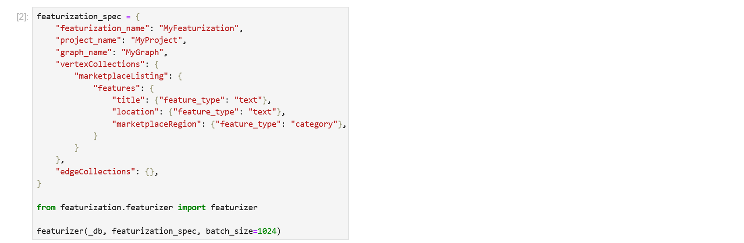
Featurization
Creating features out of your raw data is an essential part of building Machine Learning model .
You can make your graph machine learning-ready in just a few lines, via a specification:
Featurization
Notebook

Slide 26
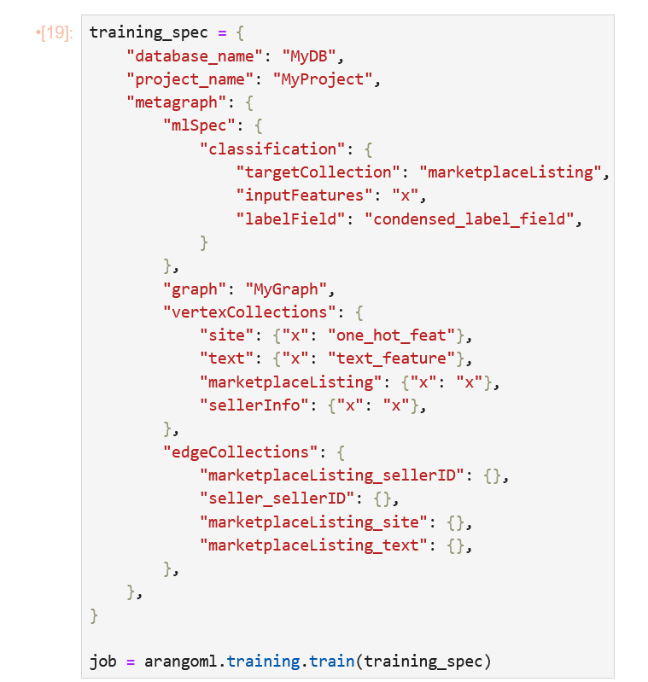
Training
Now that your data is ready for machine learning, it’s time to train the model so that it understands the data and can make predictions.
Training
Notebook

Slide 27
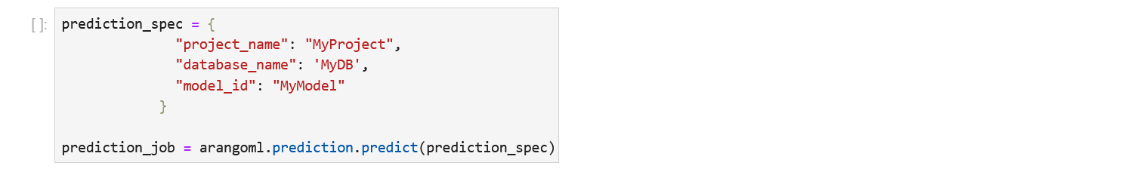
Prediction
Now you have a trained model, you can use this for predictions for new and unseen values.
Predict new results using a single command.
Prediction
Notebook

Slide 28
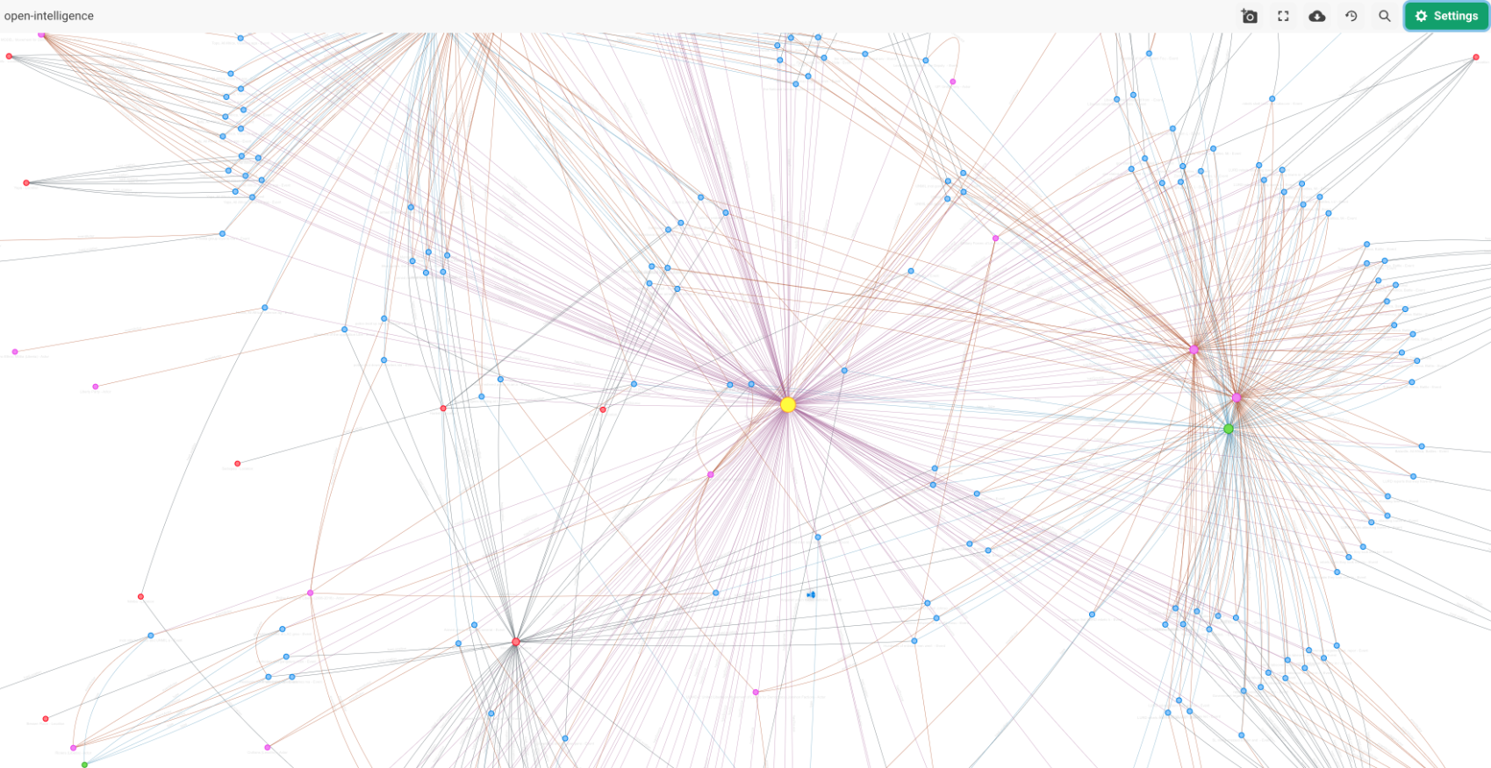
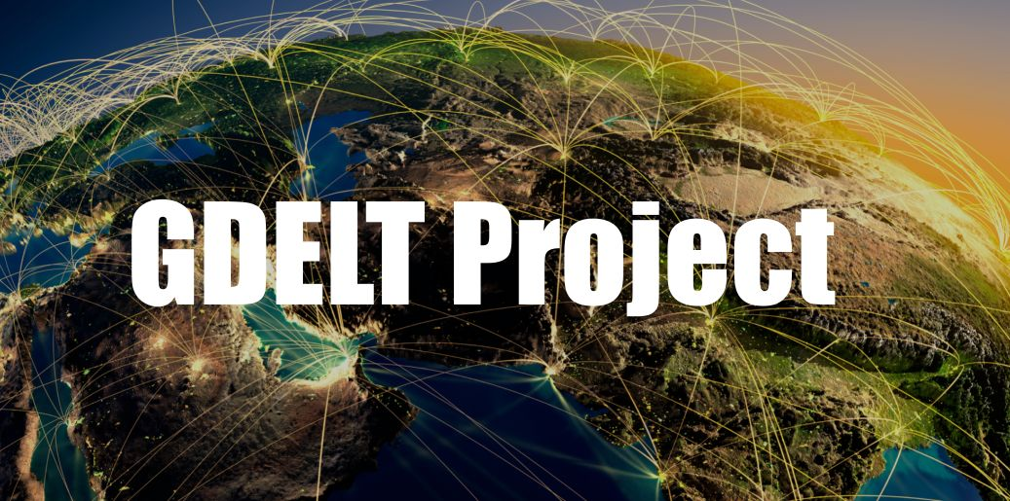
Lab: ArangoGraphML Node Classification
cloud.arangodb.com

Slide 29
Lab: ArangoGraphML Node Classification
Steps
Register your name on this Google Sheet
Go to cloud.arangodb.com
Login (top-right)
Username: asif.kazi+attendees@arangodb.com
Password: W1nt3rR@1n

Slide 30
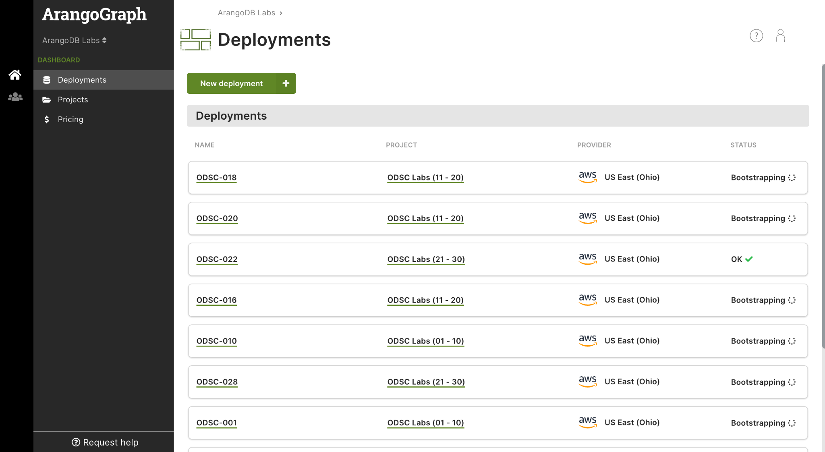

Slide 31
Lab: ArangoGraphML Node Classification
Steps (continued)
Under the Dashboard panel (Top-Left), click on Projects
Click on your designated Project, e.g ODSC Labs (01 - 10)

Slide 32
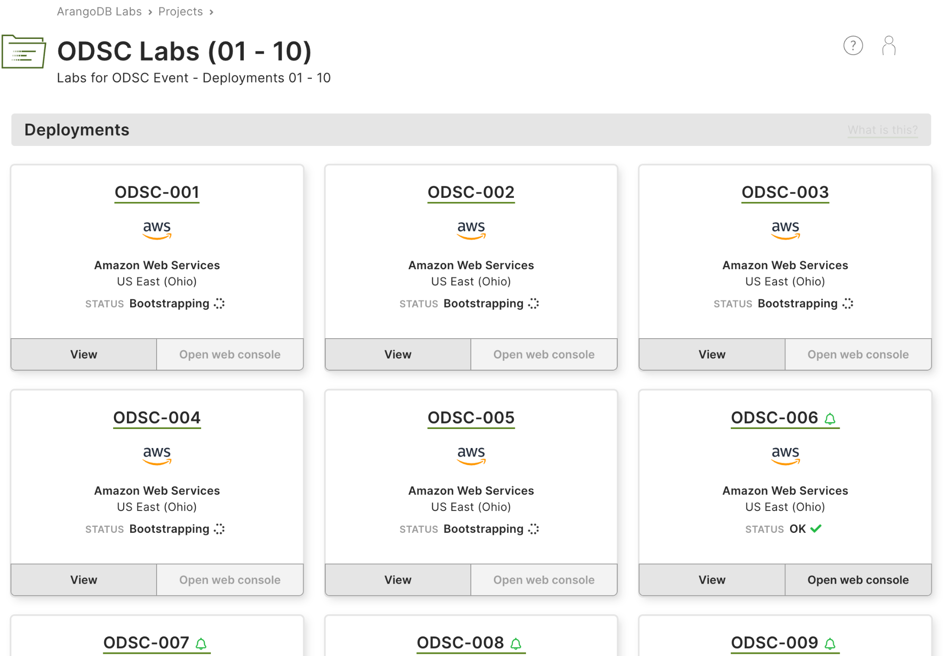

Slide 33
Lab: ArangoGraphML Node Classification
Steps (continued)
Click on your designated Deployment, e.g ODSC-001
Under the Data Science panel (Middle-left), click on Data Science
Under the Notebooks section, click Open Notebook your designated Notebook Instance

Slide 34
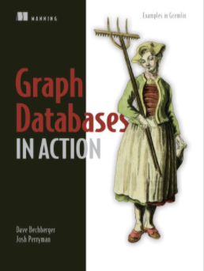
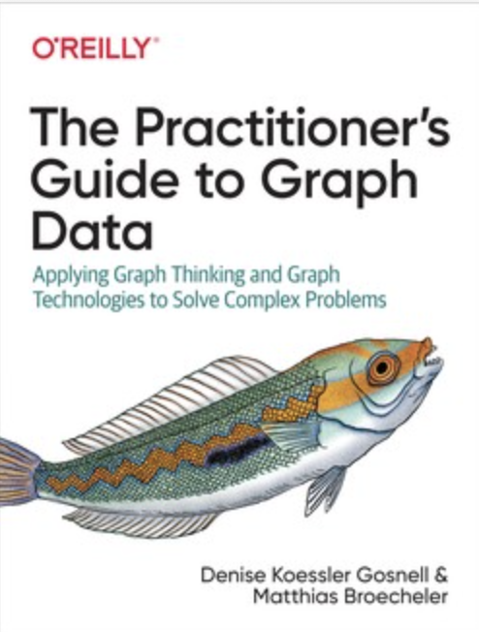
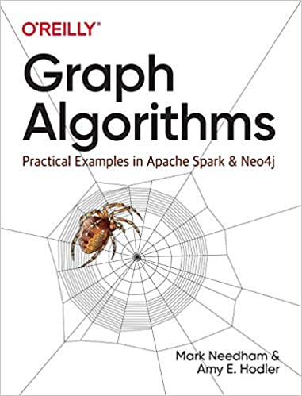
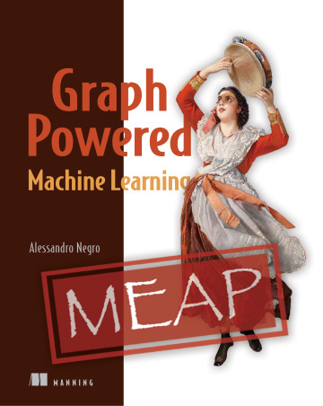

Next Steps
Where to go next?
Stanford CS224W: Machine Learning with Graphs
Thomas Kipf Blog
Graph Representation Learning Repository
Graph Representation Learning Book
https://towardsdatascience.com/graph-deep-learning/home
https://www.graphneuralnets.com/

Slide 35
Thank you!
arangodb.com/managed-ml-graph

Slide 36
[Slide Title]
[TEXT]
[TEXT]
?
?
?
Resilience
?
?
Page 36

Slide 37
Graph Analytics and GraphML
Graph
Analytics
Graph
ML

Slide 38
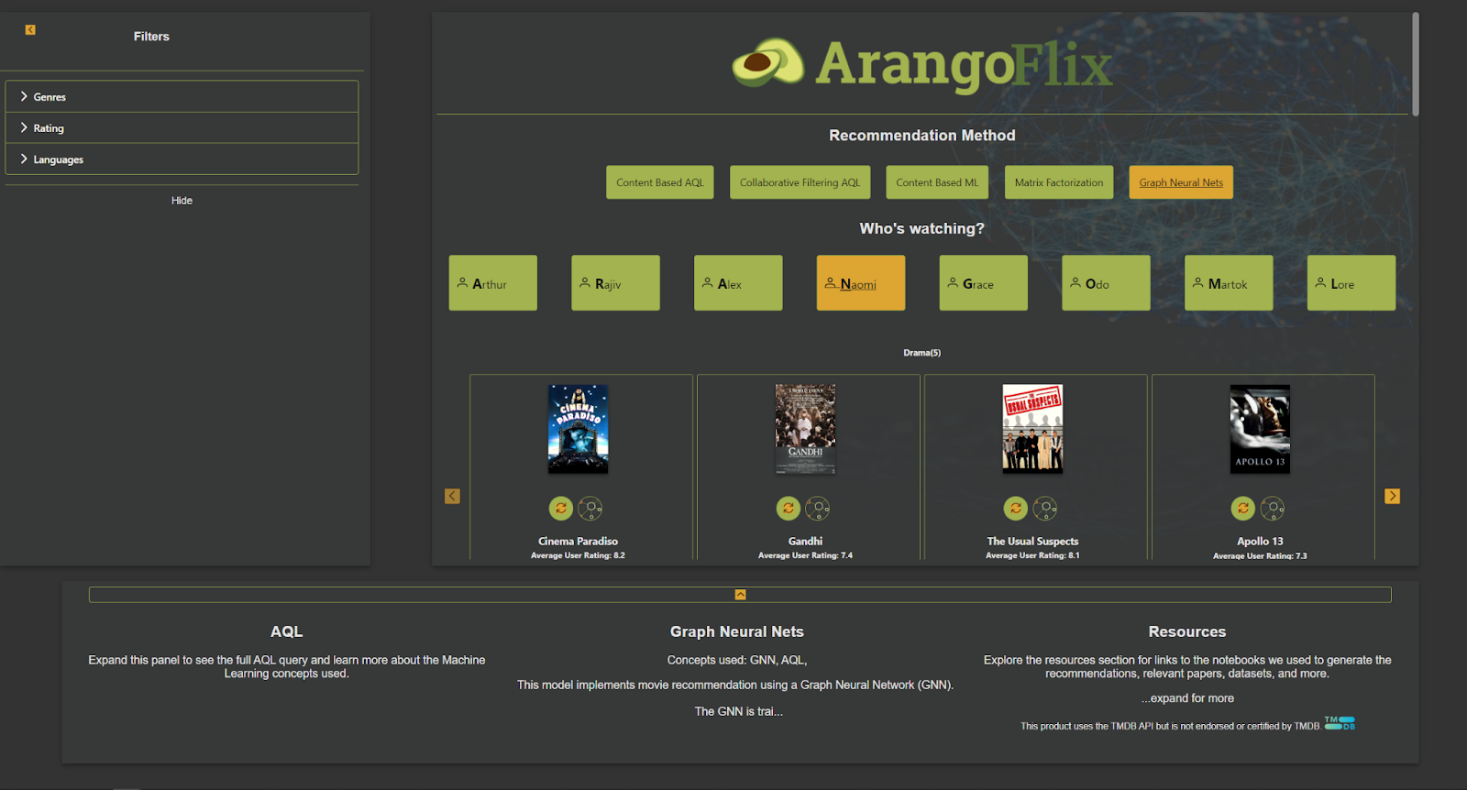
Choice

Slide 39
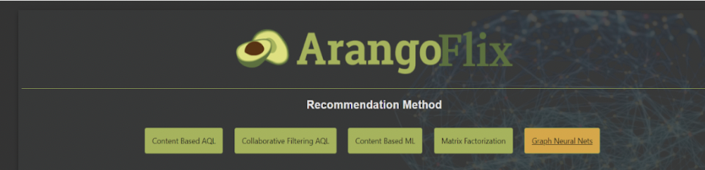
Choice
Document TFIDF
Collaborative Filtering
Embeddings
Matrix Factorization
Link Prediction

Slide 40
How to choose?
Different Criteria
Performance
Accuracy/Approximation
Explainability
Scalability
(Annotated) Data Availability
…
Graph
Analytics
GraphML

Slide 41
Performance
Graph Analytics
Depends on Algorithm
Generally depends on Graph size
Transductive
Recompute for…
New query
Updated Graph
Graph Machine Learning
Performance split across two parts
Training
Inference
Modern GML is inductive
Constant in Graph size
Depends on Model Complexity
Can use specialized hardware
Inference often faster

Slide 42
Accuracy & Approximation
Does the use-case require exact results or are approximations sufficient? E.g., Health related classification vs. product recommendation. Also related to reproducible results.
Graph Analytics
Analytical Model
Accurate/Reproducible
Can be too prohibitively expensive
Graph Machine Learning
Statistical Model
Approximation
Depends on data & model
Size
Quality
Allows control for accuracy
But still approximation

Slide 43
Explainability
Ability to reason about the inference results (understand why). Important for healthcare/finance …
Graph Analytics
Analytical Model
Can be reasoned about
Graph Machine Learning
Statistical Model
(Often) black box
Active area of research

Slide 44
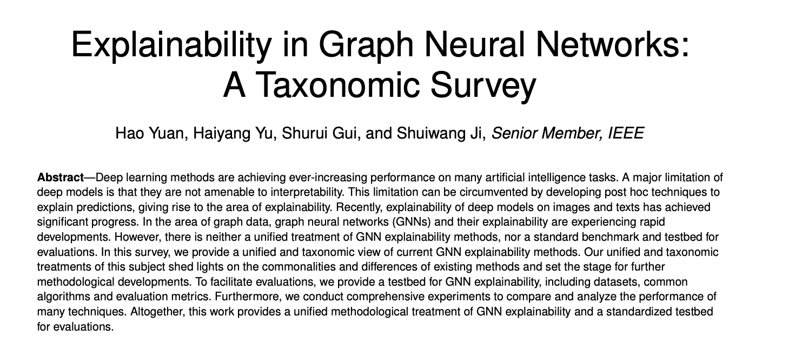
https://arxiv.org/pdf/2012.15445.pdf

Slide 45
Scalability
Ability to scale large datasets which might require distributed systems
Graph Analytics
Depends on complexity of Algorithm, but often limited
(usually) Needs to process entire Graph
Growing/updating datasets is challenging
Transductive
Graph Machine Learning
Depends on model, but usually scalable with modern GNNs (e.g, Graph Sage)
Training and Inference Scalability
Inference can often be performed locally
Complexity/Precision Tradeoff

Slide 46

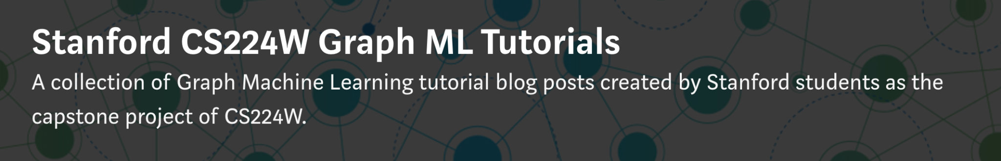
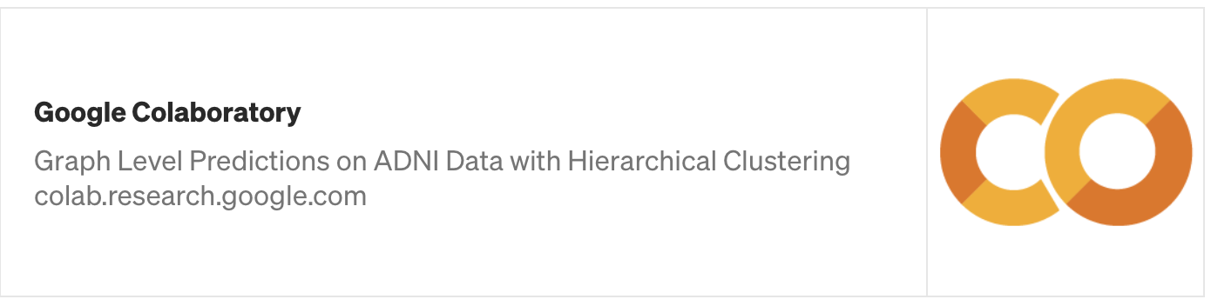
http://web.stanford.edu/class/cs224w/
https://medium.com/stanford-cs224w

Slide 47
Thanks for listening!
Where to go next?
Stanford CS224W: Machine Learning with Graphs
Thomas Kipf Blog
Graph Representation Learning Repository
Graph Representation Learning Book
https://towardsdatascience.com/graph-deep-learning/home
https://www.graphneuralnets.com/

